Slide 1
Mechanism and Consequences of Hyperoxia-Induced Oxidative Stress

Slide 2
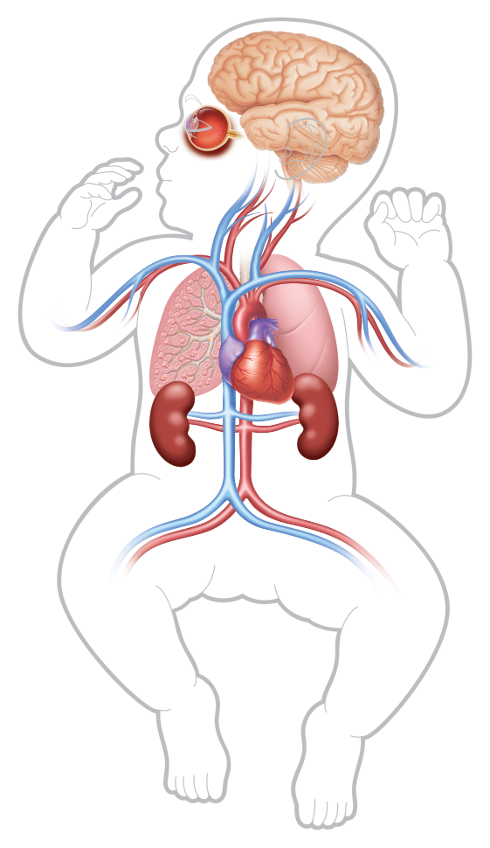
The Dichotomy of Oxygen
Oxygen is critical to life
However, too much oxygen in neonates can cause:
Oxidative stress^{1,2}
Lung injury and disease^{1,3-5}
Retinopathy of prematurity⁵
This presentation explains how hyperoxia may create reactive oxygen species (ROS) that could damage biological macromolecules
References: 1. Kulkarni AC, et al. Antioxid Redox Signal. 2007;9(10):1717-1730. 2. Saugstad OD. Biol Neonate. 2005;88(3):228-236. 3. Puthiyachirakkal M, et al. Front Pediatr. 2013;1(23):1-6. 4. Mach WJ, et al. Nurs Res Pract. 2011:260482. 5. Sola A, et al. J Perinatol. 2008;28(Suppl 1):S28-S34.
Notes:
Oxygen is critical to life. However, too much oxygen in neonates can cause:
Oxidative stress
Lung injury and disease
Retinopathy of prematurity
This presentation explains how hyperoxia may create reactive oxygen species (ROS) that could damage biological macromolecules.

Slide 3
Cellular Respiration During
Normoxia

Slide 4
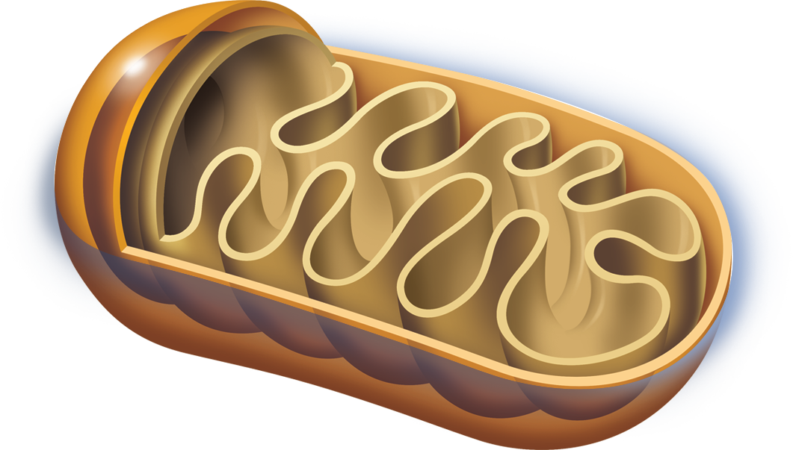
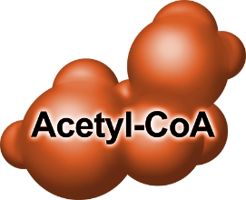
Cellular Respiration: Food → Acetyl CoA
Proteins
Carbohydrates
Lipids
Amino acids
Fatty acids and glycerol
Glucose and other sugars
Cell
Mitochondrion
Acetyl-CoA, acetyl-coenzyme A.
Reference: Murray RK, et al. Harper’s Illustrated Biochemistry, 28th ed. McGraw-Hill’s Access Medicine, 2009.
Notes:
The primary physiological role of oxygen is in cellular respiration. This process begins with the breakdown of food and the generation of acetyl-CoA in the mitochondria.

Slide 5
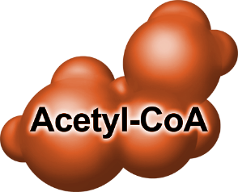
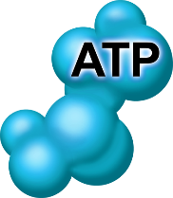
Cellular Respiration: Acetyl CoA → Citric Acid Cycle → Electron Transport
Electron transport via
NADH and FADH₂
Cell
Mitochondrion
NADH, nicotinamide adenine dinucleotide;
FADH₂, flavin adenine dinucleotide
Reference: Murray RK, et al. Harper’s Illustrated Biochemistry, 28th ed. McGraw-Hill’s Access Medicine, 2009.
Notes:
Within the mitochondria, acetyl-CoA enters the citric acid or Krebs cycle. Output of this cycle includes ATP as well as two types of molecules—NADH and FADH₂—that carry electrons to the last stage of cellular respiration, the electron transport system.

Slide 6
Cellular Respiration: Electron Transport System
Intermembrane
Space
NORMOXIA
Membrane
Outer Mitochondrial Membrane
Mitochondrial
Inner
Electron Transport System
Reference: Murray RK, et al. Harper’s Illustrated Biochemistry, 28th ed. McGraw-Hill’s Access Medicine, 2009.
Notes:
The electron transport system is a complex series of chemical reactions that occurs across and within the inner mitochondrial membrane.

Slide 7
Cellular Respiration: Electrons Are From Citric Acid Cycle
Intermembrane
Space
NORMOXIA
Membrane
Outer Mitochondrial Membrane
Mitochondrial
Inner
Reference: Murray RK, et al. Harper’s Illustrated Biochemistry, 28th ed. McGraw-Hill’s Access Medicine, 2009.
Notes:
The electron carriers NADH and FADH₂ move electrons from the citric acid cycle to the electron transport system.

Slide 8
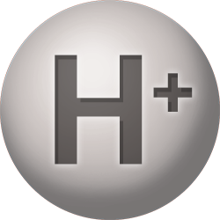
Cellular Respiration: Electrons Used to Transport H⁺ Across Membrane
Intermembrane
Space
NORMOXIA
Membrane
Outer Mitochondrial Membrane
Mitochondrial
Inner
Reference: Murray RK, et al. Harper’s Illustrated Biochemistry, 28th ed. McGraw-Hill’s Access Medicine, 2009.
Notes:
In a multi-step process, the electrons are used to actively transport hydrogen ions—or protons—across the inner mitochondrial membrane.

Slide 9
Cellular Respiration: Resulting H⁺ Gradient Used to Generate ATP
Intermembrane
Space
NORMOXIA
Membrane
Outer Mitochondrial Membrane
Mitochondrial
ATP Synthase
Inner
Reference: Murray RK, et al. Harper’s Illustrated Biochemistry, 28th ed. McGraw-Hill’s Access Medicine, 2009.
Notes:
The resulting gradient in hydrogen ions is used to generate ATP via ATP synthase.

Slide 10
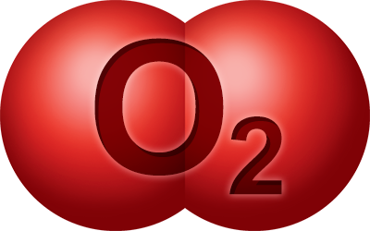
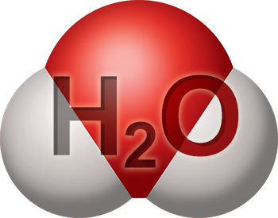
Cellular Respiration: Electrons Leaving System Accepted by Oxygen
Intermembrane
Space
NORMOXIA
Membrane
Outer Mitochondrial Membrane
Mitochondrial
Inner
Reference: Murray RK, et al. Harper’s Illustrated Biochemistry, 28th ed. McGraw-Hill’s Access Medicine, 2009.
Notes:
The electrons that leave the electron transport system are accepted by oxygen and, in the presence of hydrogen ions, form water.

Slide 11
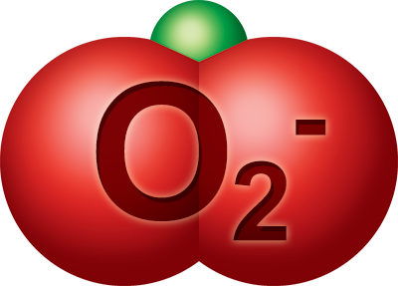
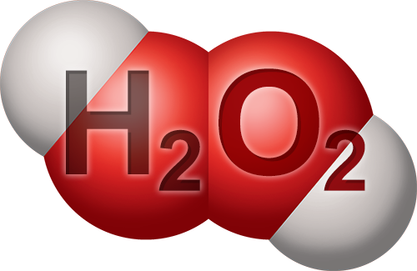
Cellular Respiration: A Few Electrons Leak and Create ROS
Intermembrane
Space
NORMOXIA
Membrane
Outer Mitochondrial Membrane
Mitochondrial
Inner
Reactive oxygen species (ROS)
O₂ → O₂⁻ → H₂O₂ → HO• → H₂O
References: 1. Murray RK, et al. Harper’s Illustrated Biochemistry, 28th ed. McGraw-Hill’s Access Medicine, 2009. 2. McCord JM. Am J Med. 2000;108(8):652-659. 3. Mach WJ, et al. Nurs Res Pract. 2011:260482.
Notes:
However, under normal conditions, 1-2% of electrons leak from the electron transport system. These electrons interact with oxygen to form reactive oxygen species (ROS).

Slide 12
Cellular Respiration: During Normoxia, Cell Can Neutralize Most ROS
Intermembrane
Space
NORMOXIA
Membrane
Outer Mitochondrial Membrane
Mitochondrial
Inner
Reactive oxygen species (ROS)
Antioxidants
(eg, SOD, GSH, catalase)
References: 1. Murray RK, et al. Harper’s Illustrated Biochemistry, 28th ed. McGraw-Hill’s Access Medicine, 2009. 2. McCord JM. Am J Med. 2000;108(8):652-659. 3. Mach WJ, et al. Nurs Res Pract. 2011:260482.
Notes:
During normoxia, cells can neutralize most ROS using antioxidants (for example, SOD, GSH, catalase).

Slide 13
Cellular Respiration During
Hypoxia

Slide 14
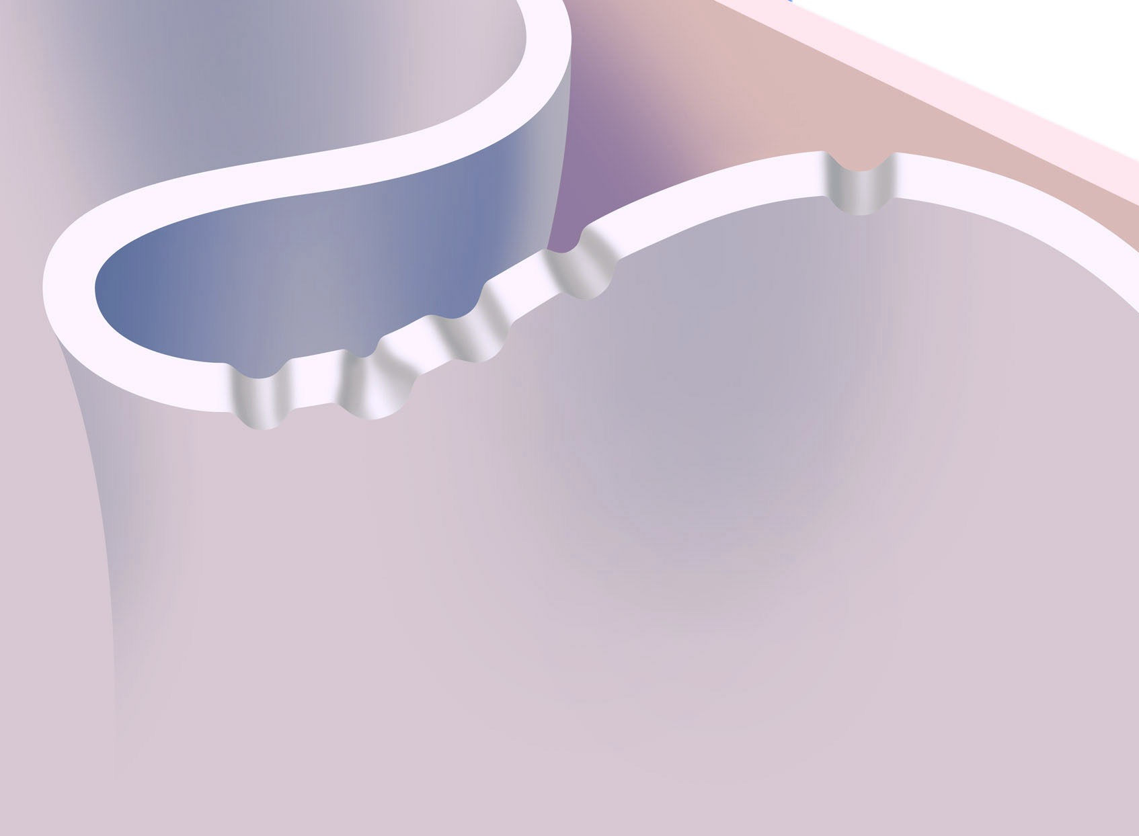
Hypoxia: Less O₂ → Slowed Electron Transport → Less ATP
Intermembrane
Space
Hypoxia
Membrane
Outer Mitochondrial Membrane
Mitochondrial
Inner
Inadequate energy to maintain cell function
References: 1. Murray RK, et al. Harper’s Illustrated Biochemistry, 28th ed. McGraw-Hill’s Access Medicine, 2009. 2. Michiels C. Am J Pathol. 2004;164(6):1875-1882. 3. Tafani M, et al. Oxid Med Cell Longev. 2016:3907147.
Notes:
During hypoxia, less oxygen is available to take up electrons, so the electron transport system slows and less ATP is produced. With less energy available, the cell’s ability to maintain vital ionic concentration gradients is compromised. In extreme hypoxia, this imbalance can cause swelling, membrane rupture, and cell death.

Slide 15
Hypoxia: Less O₂ → More ROS Created (Mechanism Under Debate)
Intermembrane
Space
Hypoxia
Membrane
Outer Mitochondrial Membrane
Mitochondrial
Inner
Inadequate energy to maintain cell function
References: 1. Murray RK, et al. Harper’s Illustrated Biochemistry, 28th ed. McGraw-Hill’s Access Medicine, 2009. 2. Michiels C. Am J Pathol. 2004;164(6):1875-1882. 3. Tafani M, et al. Oxid Med Cell Longev. 2016:3907147.
Notes:
Hypoxia also increases electron leakage from the electron transport chain, which results in increased formation of ROS. The mechanism by which hypoxia increases electron leakage is still under debate.
Hypoxia also increases electron leakage from the electron transport chain, which results in increased formation of ROS. The mechanism by which hypoxia increases electron leakage is still under debate.

Slide 16
Hypoxia: More ROS with Inadequate Antioxidants → Oxidative Stress
Intermembrane
Space
Hypoxia
Membrane
Outer Mitochondrial Membrane
Mitochondrial
Inner
Inadequate energy to maintain cell function
Inadequate
antioxidants
References: 1. Murray RK, et al. Harper’s Illustrated Biochemistry, 28th ed. McGraw-Hill’s Access Medicine, 2009. 2. Michiels C. Am J Pathol. 2004;164(6):1875-1882. 3. Tafani M, et al. Oxid Med Cell Longev. 2016:3907147.
Notes:
ROS levels in excess of the cell’s antioxidant capabilities can cause oxidative stress.
ROS levels in excess of the cell’s antioxidant capabilities can cause oxidative stress.

Slide 17
Cellular Respiration During
Hyperoxia

Slide 18
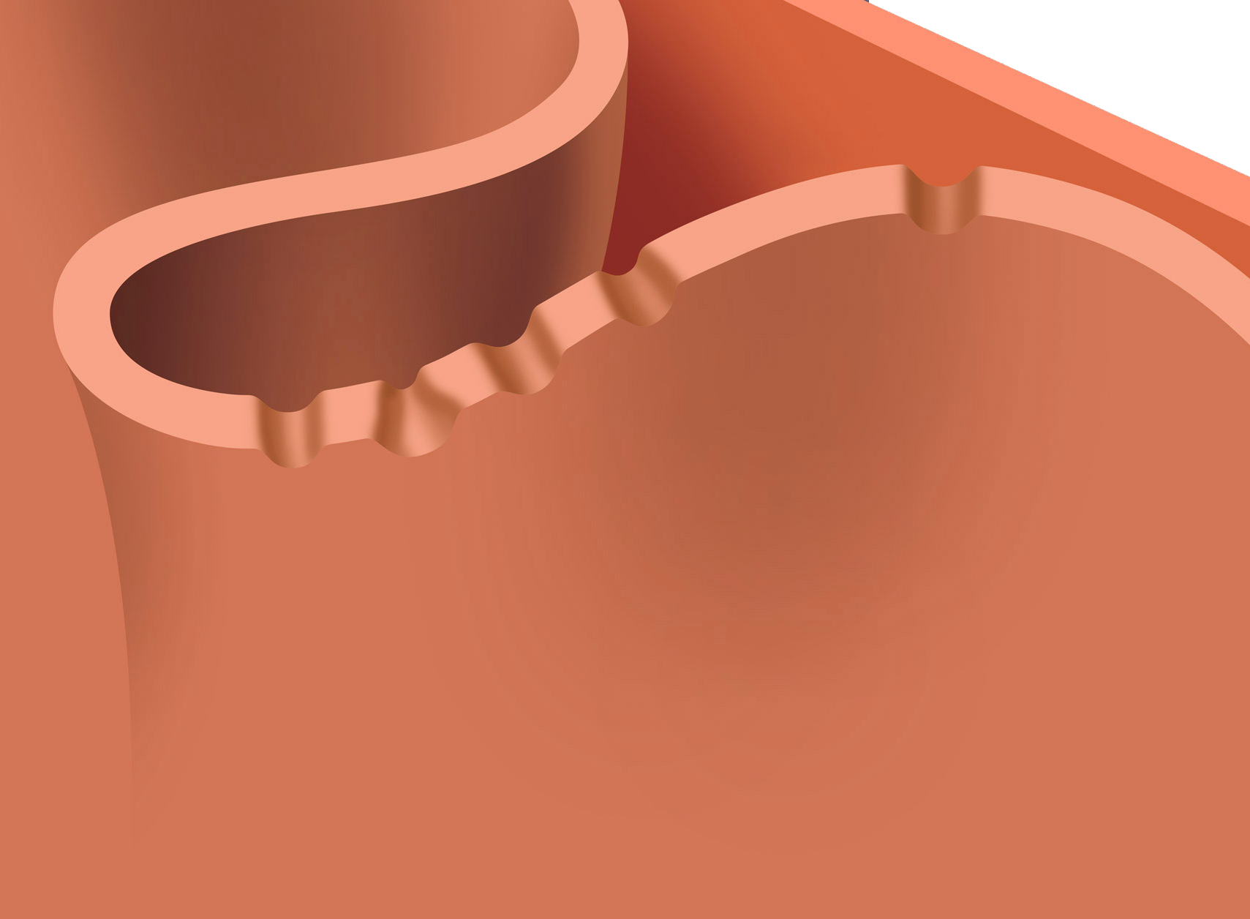
Hyperoxia: Excess O₂ → More Electron Leakage → Fewer ATP
Intermembrane
Space
HypERoxia
Membrane
Outer Mitochondrial Membrane
Mitochondrial
Inner
References: 1. Murray RK, et al. Harper’s Illustrated Biochemistry, 28th ed. McGraw-Hill’s Access Medicine, 2009. 2. McCord JM. Am J Med. 2000;108(8):652-659. 3. Mach WJ, et al. Nurs Res Pract. 2011:260482. 4. Turrens. J Physiol. 2003;552(2):335-344.
Notes:
During hyperoxia, leakage from the electron transport system increases and the overall activity of the electron transport system decreases. As a result, fewer ATP are formed.

Slide 19
Hyperoxia: More Electron Leakage → More ROS
Intermembrane
Space
HypERoxia
Membrane
Outer Mitochondrial Membrane
Mitochondrial
Inner
References: 1. Murray RK, et al. Harper’s Illustrated Biochemistry, 28th ed. McGraw-Hill’s Access Medicine, 2009. 2. McCord JM. Am J Med. 2000;108(8):652-659. 3. Mach WJ, et al. Nurs Res Pract. 2011:260482. 4. Turrens. J Physiol. 2003;552(2):335-344.
Notes:
Increased electron leakage leads to creation of additional ROS. The rate of ROS formation increases with the concentration of oxygen.
Increased electron leakage leads to creation of additional ROS. The rate of ROS formation increases with the concentration of oxygen.

Slide 20
Hyperoxia: More ROS with Inadequate Antioxidants → Oxidative Stress
Intermembrane
Space
HypERoxia
Membrane
Outer Mitochondrial Membrane
Mitochondrial
Inner
Inadequate
antioxidants
References: 1. Murray RK, et al. Harper’s Illustrated Biochemistry, 28th ed. McGraw-Hill’s Access Medicine, 2009. 2. McCord JM. Am J Med. 2000;108(8):652-659. 3. Mach WJ, et al. Nurs Res Pract. 2011:260482.
Notes:
ROS levels in excess of the cell’s antioxidant capabilities cause oxidative stress.
ROS levels in excess of the cell’s antioxidant capabilities cause oxidative stress.

Slide 21
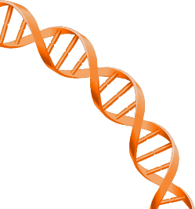
ROS and Oxidative Stress Can Damage Biological Macromolecules
DNA
Strand breakage¹
Mutations, deletions, and translocations¹
Cross-linking with proteins¹
Abnormal protein expression¹
Cancer^{3,4}
ROS
Proteins
Alterations in activity of enzymes, receptors, and membrane transport^{3,5}
Increased membrane permability¹
Clinical manifestations, such as retinopathy of prematurity⁶
Chain fragmentation¹
Cross-linking with other proteins¹
Altered electrical charge¹
ROS
References: 1. Birben E, et al. World Allergy Organ J. 2012;5(1):9-19. 2. Mu H, et al. Int J Mol Sci. 2012;13(7):9194-9206. 3. Machlin LJ, Bendich A. FASEB J. 1987;1(6):441-445.
4. Naumberg E, et al. Acta Paediatr. 2002;91(12):1328-1333. 5. Lobo V, et al. Pharmacogn Rev. 2010;4(8):118-126. 6. Perrone S, et al. Adv Biosci Biotech. 2012;3(7A):1043-1050.
Notes:
ROS and oxidative stress can damage biological macromolecules, including DNA and proteins. The results of this damage may include abnormal protein expression, increased membrane permeability, and clinical manifestations, such as cancer and retinopathy of prematurity.

Slide 22
Summary
The main physiological role of oxygen is to accept electrons exiting the electron transport chain^{1,2}
During normoxia, a small percentage of electrons leak out of the electron transport system and interact with oxygen to form reactive oxygen species (ROS)^{2,3}
However, the cell produces antioxidants to neutralize most ROS
During hypoxia and hyperoxia, the percentage of electrons leaking from the transport system increases²⁻⁴
As a result, ROS formation increases
If ROS formation exceeds the cell’s capacity to neutralize ROS, oxidative stress occurs
Oxidative stress can damage biological macromolecules and lead to clinical manifestations, including cancer and retinopathy of prematurity⁵⁻⁷
References: 1. Murray RK, et al. Harper’s Illustrated Biochemistry, 28th ed. McGraw-Hill’s Access Medicine, 2009. 2. McCord JM. Am J Med. 2000;108(8):652-659. 3. Mach WJ, et al. Nurs Res Pract. 2011:260482. 4. Turrens JF. J Physiol. 2003;522(2):335-344. 5. Machlin LJ, Bendich A. FASEB J. 1987;1(6):441-445. 6. Naumberg E, et al. Acta Paediatr. 2002;91(12):1328-1333. 7. Perrone S, et al. Adv Biosci Biotech. 2012;3(7A):1043-1050.

Slide 23
Mallinckrodt, the “M” brand mark and the Mallinckrodt Pharmaceuticals logo are trademarks of a Mallinckrodt company. Other brands are trademarks of a Mallinckrodt company or their respective owners.
© 2017 Mallinckrodt US PRC/1116/0099 January 2017

